Slide 1
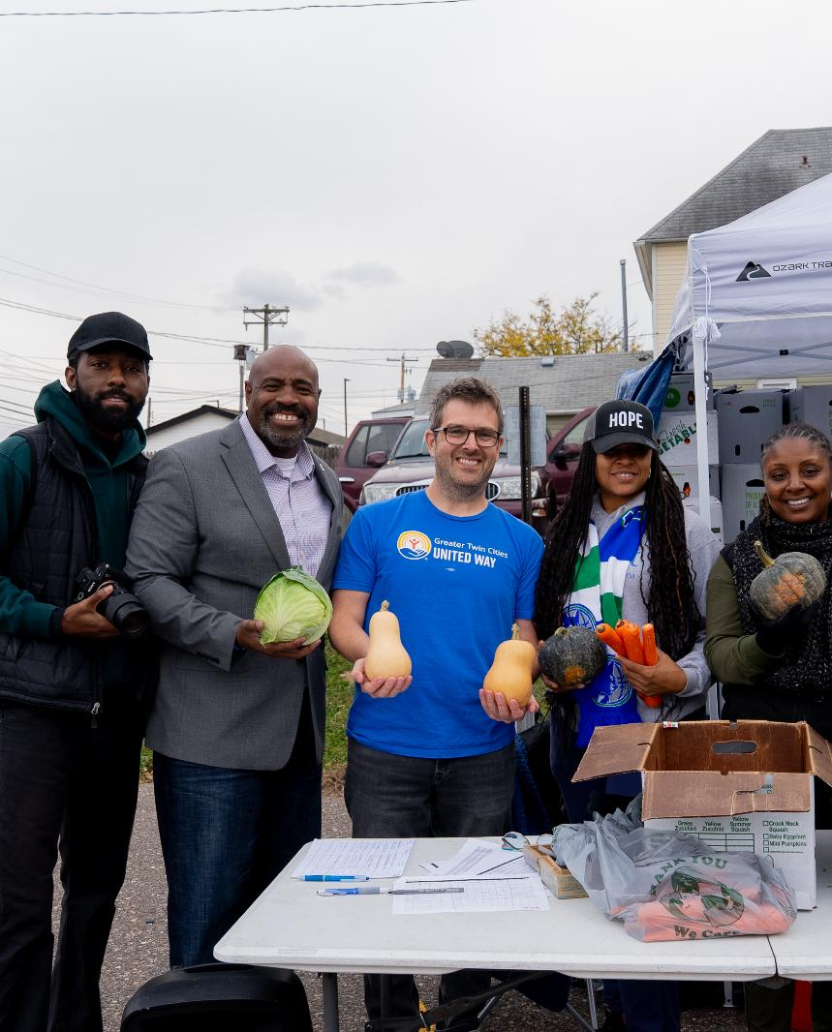
UNITED IS THE WAY
Our vision, strategies and impact

Slide 2

Our shared vision of a community where all people thrive regardless of income, race or place matters now more than ever.

Slide 3
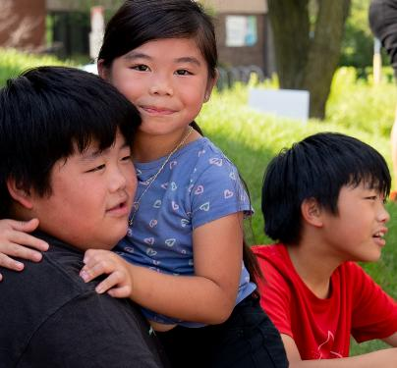
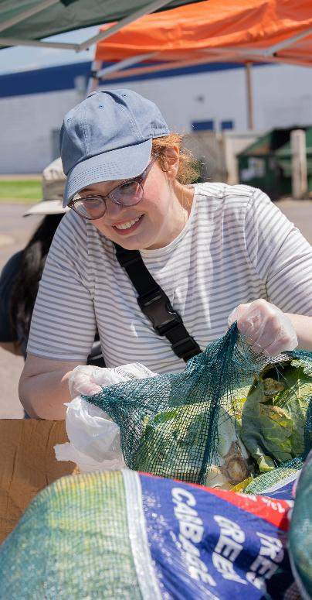
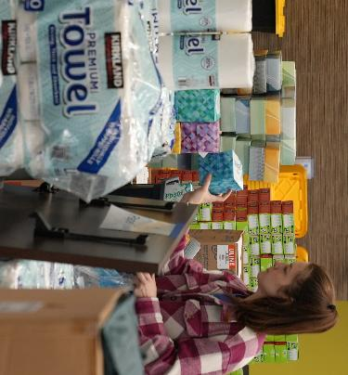
Thriving means being able to consistently:
• Cover the basics: housing, child care, food, transportation, health care, and technology to connect with work, school and community.
• Manage emergencies, whether community-wide (like the impacts of policy changes) or personal (such as car trouble).
• Save for the future.
Notes:
We’re all better off when everyone has stable housing, nutritious food, opportunities to learn, and careers that support our families.
Thriving means being able to consistently:
• Cover the basics: housing, child care, food, transportation, health care, and technology to connect with work, school and community. (For those familiar with ALICE, this is what we include in the ALICE survival budget.)
• Manage emergencies, whether community-wide (like the impacts of policy changes) or personal (such as car trouble).
• Save for the future.
This is what United for ALICE calls a stability budget, and it’s 10% above the ALICE threshold.

Slide 4
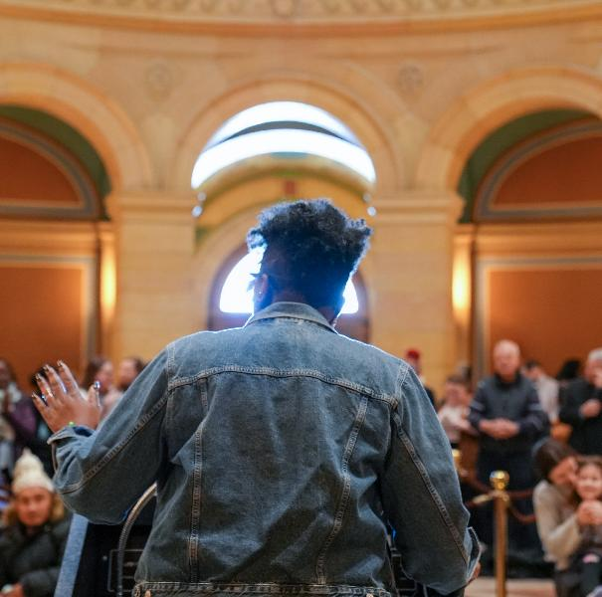
We’re here for this.
Greater Twin Cities United Way has been earning trust and building relationships among nonprofits, volunteers, donors and employers to support our community for 110 years.
We’ve stuck together through wars, pandemics and changing political landscapes.
What comes next will look different from what we’re used to, and we will build it together.
Notes:
Greater Twin Cities United Way has been earning trust and building relationships among nonprofits, volunteers, donors and employers to support our community for 110 years.
We’ve stuck together through wars, pandemics and changing political landscapes.
What comes next will look different from what we’re used to, and we will build it together.

Slide 5
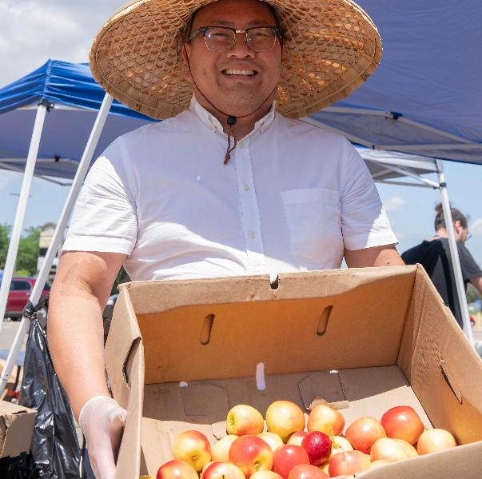
United, we’ve already begun.
Our trusted partnerships enable us to quickly move funds, information and people to do the most good.
We respond. Ensuring people stay housed and fed makes our community better able to weather crises.
We stabilize. We support nonprofits doing the best work to meet urgent needs in housing, food, education and economic opportunity.
We keep investing in a thriving future. Greater Twin Cities United Way is unique because we never stop working toward equity even while responding to urgent needs.
Notes:
Our trusted partnerships enable us to quickly move funds, information and people to do the most good:
We respond. Ensuring people stay housed and fed makes our community better able to weather crises. Our 211 resource helpline connects callers to resources to meet basic needs, often answering spikes in calls during emergencies. To support frontline nonprofits to adapt, we make emergency grants. And our volunteers show up with urgency.
We stabilize. We support nonprofits doing the best work to meet urgent needs in housing, food, education and economic opportunity. Partners tell us that our multiyear unrestricted funds, free consulting services and personal relationships provide a rare source of reliability through turmoil.
We keep investing in a thriving future. Greater Twin Cities United Way is unique because we never stop working toward equity even while responding to urgent needs. This means investing in the trauma-informed practices that nurture childhood brain development, building systems to prevent homelessness before it starts, and continuing to engage with lawmakers across the political spectrum.

Slide 6
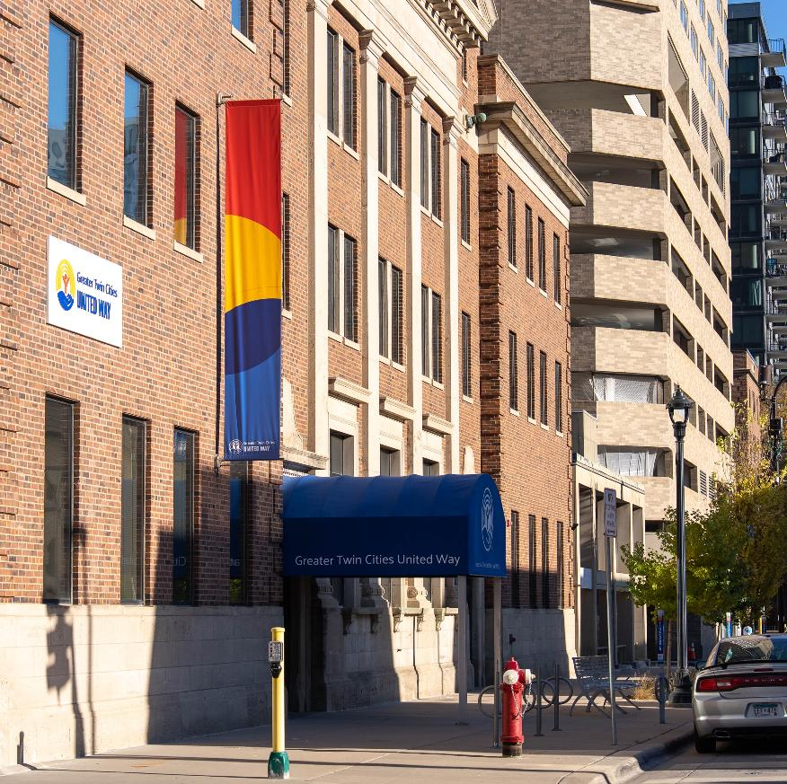
Our mission is to unite changemakers, advocate for social good and develop solutions to the challenges no one can solve alone.

Slide 7

We invite you to join us by:
Volunteering
Donating
Advocating for a community where everyone can succeed

Slide 8
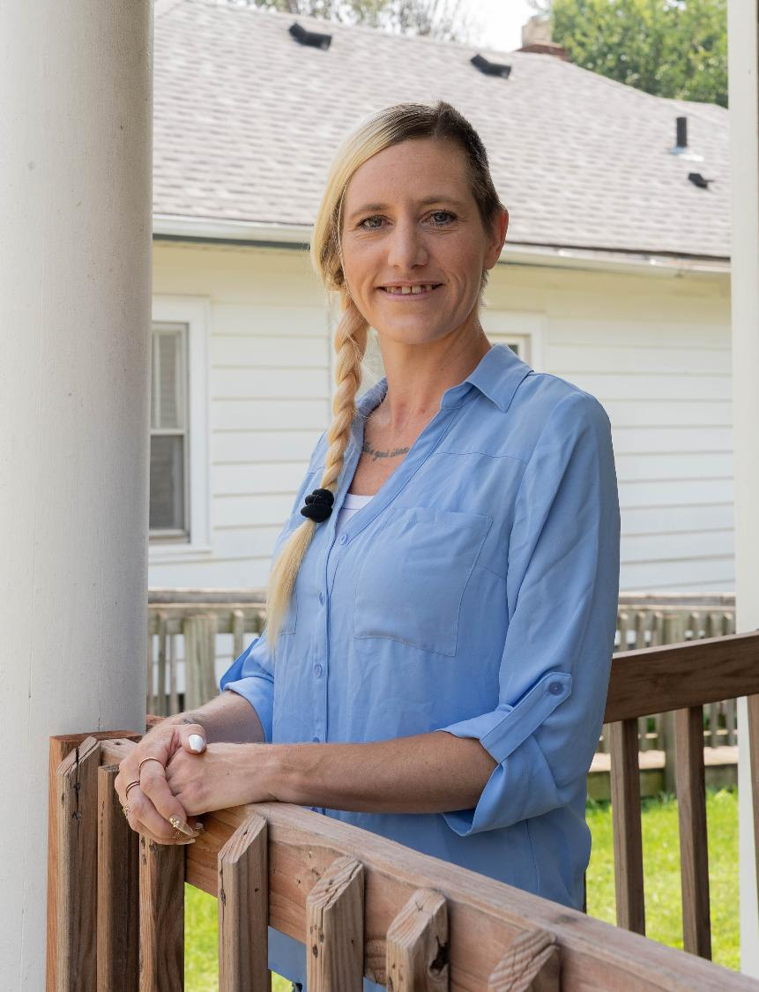
STABLE HOUSING
UNITED IS THE WAY

Slide 9
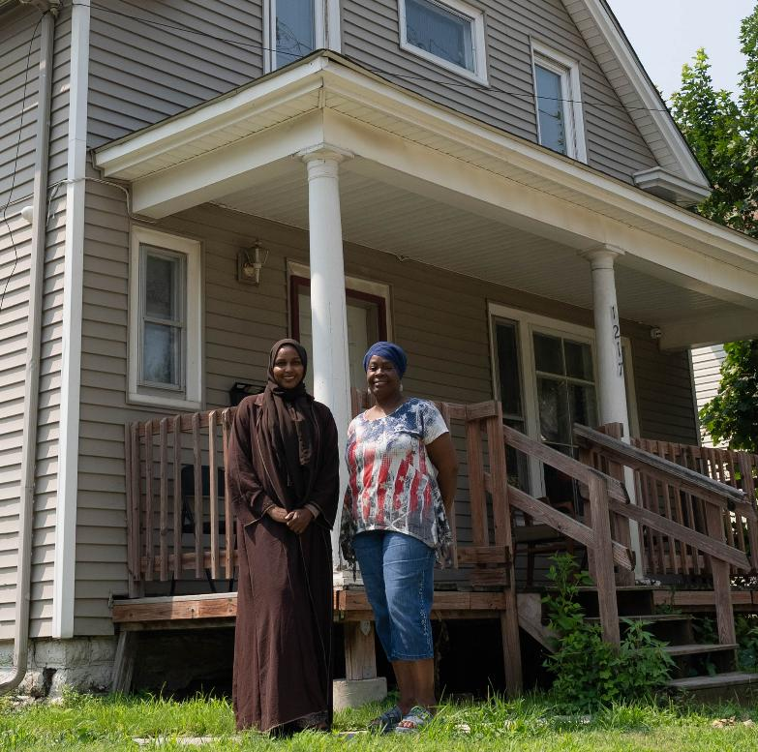
We meet urgent needs
211 specialists connect callers to emergency shelter and other services. Housing is by far the greatest reason people reach out to 211.
We support the most effective nonprofits providing shelter and holistic services that help stabilize lives.
Home For Good volunteers provide families with welcome home bins filled with towels, kitchen utensils, cleaning and hygiene items, blankets and other necessities to set up and keep a safe, stable home.
Notes:
211 specialists connect callers to emergency shelter and other services. Housing is by far the greatest reason people reach out to 211.
We support the most effective nonprofits providing shelter and holistic services that help stabilize lives.
This support is what our grantmaking team does every day.
It comes in the form of flexible, reliable multiyear funding
And we provide free consulting, which our partners tell us is crucial for their organizational stability. This means a lot in a turbulent funding and policy landscape.
Home For Good volunteers provide families with welcome home bins filled with towels, kitchen utensils, cleaning and hygiene items, blankets and other necessities to set up and keep a safe, stable home.

Slide 10
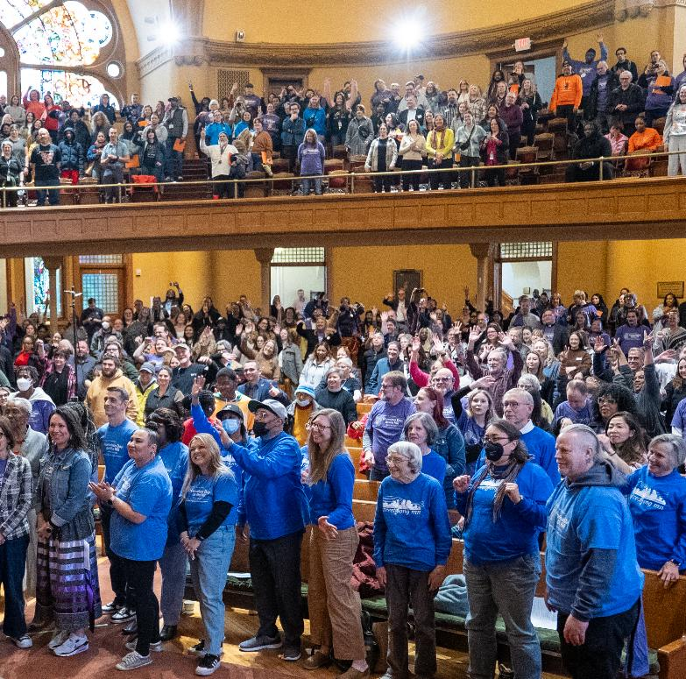
We make lasting change
Our Pathways Home initiative works to prevent homelessness by fixing gaps in the foster care and criminal-legal systems so all young people have stable housing and support to achieve their dreams.
We lead advocacy to increase safe, affordable housing for adults and children at the highest risk of homelessness.

Slide 11
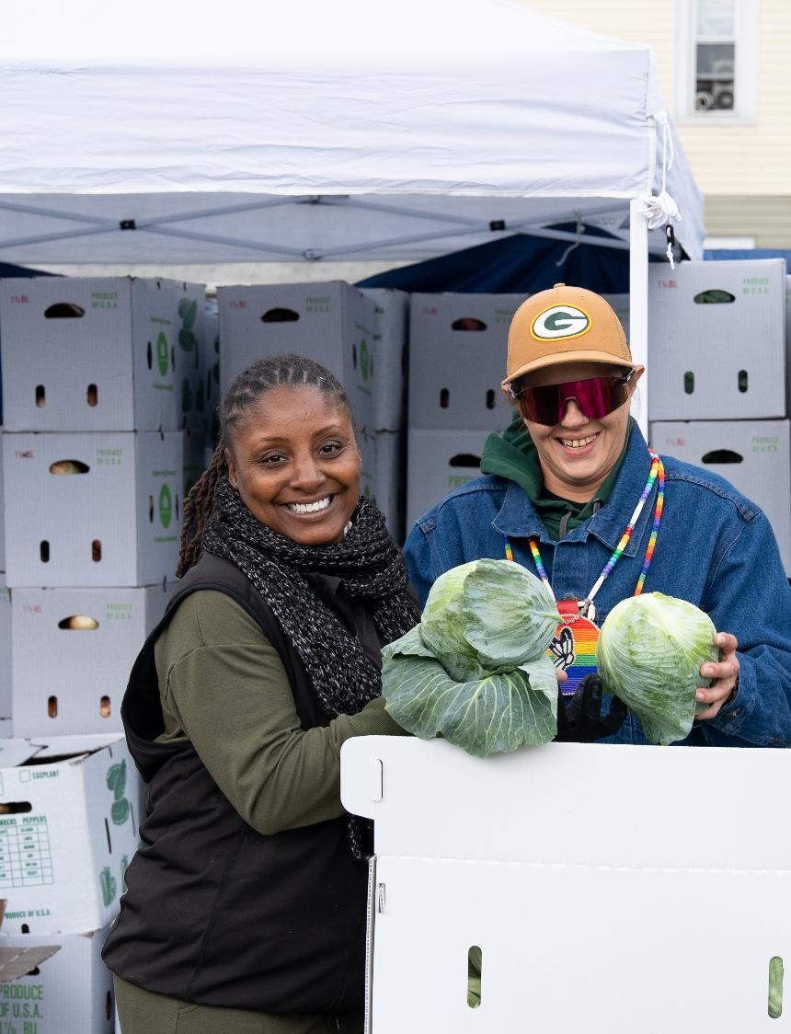
FOOD SECURITY
UNITED IS THE WAY

Slide 12
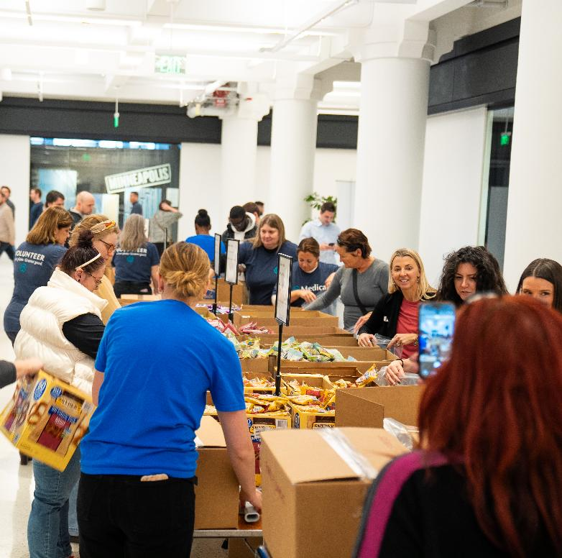
We meet urgent needs
211 callers connect to food pantries and meal programs. Often, when callers ask about food, our resource specialists can identify additional relevant services such as utility assistance or employment training.
We support the most effective nonprofits providing emergency food services and helping families reduce the likelihood of future hunger.
Flavors of Our Community volunteers increase the supply of in-demand foods.
Notes:
Here’s how we meet urgent needs for food:
Connecting 211 callers to food pantries and meal programs. Food-related requests surged in the fall of 2025 on top of years of steady and accelerating growth. Often, when callers ask about food, our 211 resource specialists can identify additional relevant services such as utility assistance or employment training.
Supporting the nonprofits that are most effective at providing emergency food services and connections to benefits so families can reduce the likelihood of future hunger.
This support is what our grantmaking team does every day.
It comes in the form of flexible, reliable multiyear funding
And we provide free consulting, which our partners tell us is crucial for their organizational stability. This means a lot in a turbulent funding and policy landscape.
As our nonprofit partners continue to see record-breaking demand for food, they use our flexible funding and free consulting services to grow their reach.
We increase the supply of in-demand foods (including for many cultures, ages and abilities) through our Flavors of Our Community volunteer initiative.

Slide 13
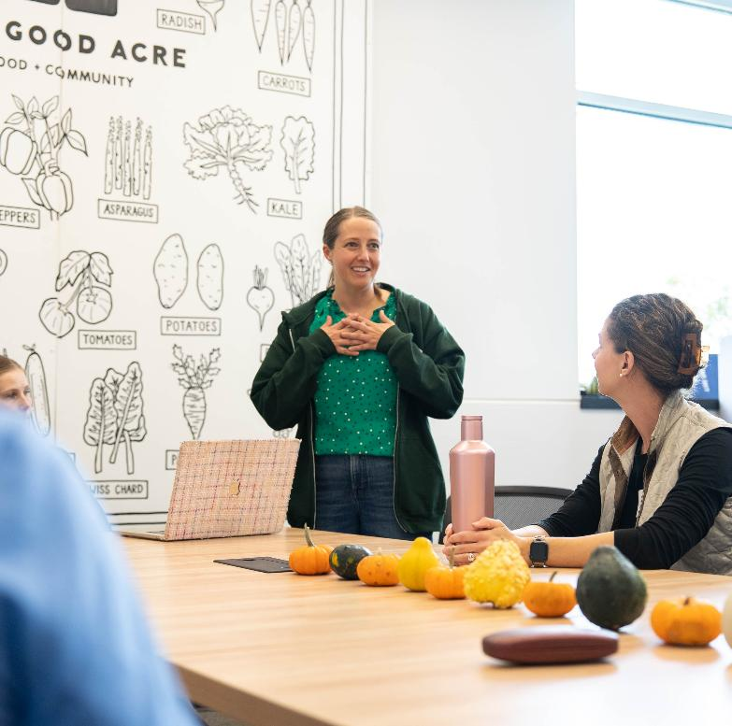
We make lasting change
Our Full Lives initiative is creating a thriving regional food system where all communities can get food that meets their cultural, dietary and nutritional needs.
We lead advocacy to promote thriving, healthy communities by improving how food is produced, distributed and consumed.
Notes:
Here’s how we make lasting change to improve our region's food security:
Leading our Full Lives initiative to create a thriving regional food system where all communities can get food that meets their cultural, dietary and nutritional needs.
Leading advocacy to promote thriving, healthy communities by improving how food is produced, distributed and consumed.

Slide 14
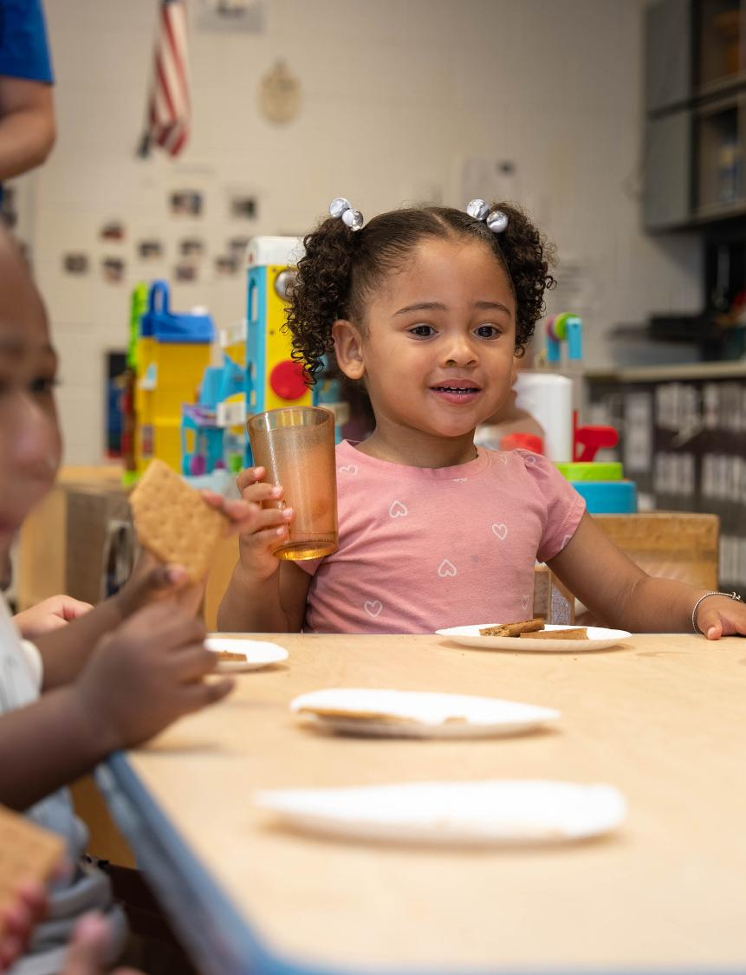
EDUCATION
UNITED IS THE WAY

Slide 15
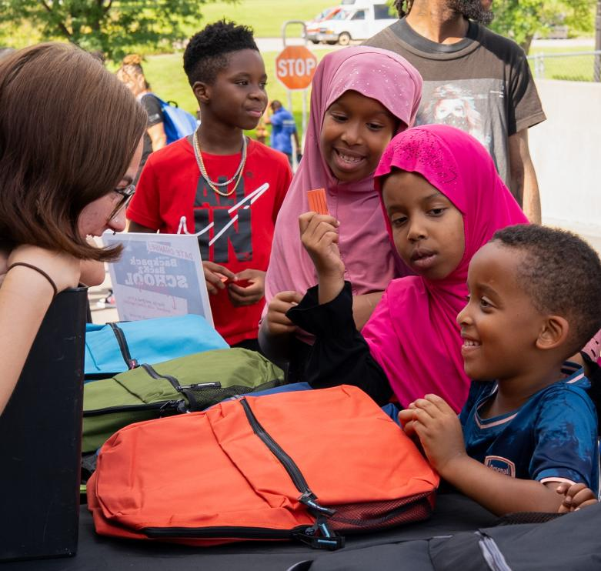
We meet urgent needs
Parents and educators use 211 to find resources that help families meet their basic needs and find learning opportunities.
We support nonprofits doing the best work in early childhood care and education and youth services.
Action Day volunteers provide backpacks full of supplies so K-12 students go back to school ready to learn.
Notes:
Here’s how we meet urgent needs in education:
Connecting parents and educators via 211 to resources that help families meet their basic needs and find learning opportunities.
Responding to mental health crises and ongoing needs through the 988 Suicide & Crisis Lifeline and 211. One in 10 callers to 988 is a child younger than 15.
Supporting early childhood care and education partners committed to children’s development and parents’ success. Early-childhood success provides a strong foundation from which people achieve greater life outcomes in community, academics, health and the workforce.
Supporting youth-serving organizations aligned with young people’s developmental and cultural strengths.
When I talk about "support" for those nonprofits, it's what our grantmaking team does every day.
It comes in the form of flexible, reliable multiyear funding
And we provide free consulting, which our partners tell us is crucial for their organizational stability. This means a lot in a turbulent funding and policy landscape.
Early-childhood partners use our flexible funding and free consulting services to adapt to support families in a landscape where funding and safety concerns can change rapidly.
An example from youth development is that in 2025, a partner used our flexible funding and free consulting to help restructure its leadership for greater effectiveness and community engagement.
Leading our annual Action Day volunteer initiative, in which thousands of volunteers and donors join forces to provide backpacks full of supplies so K-12 students go back to school ready to learn.

Slide 16
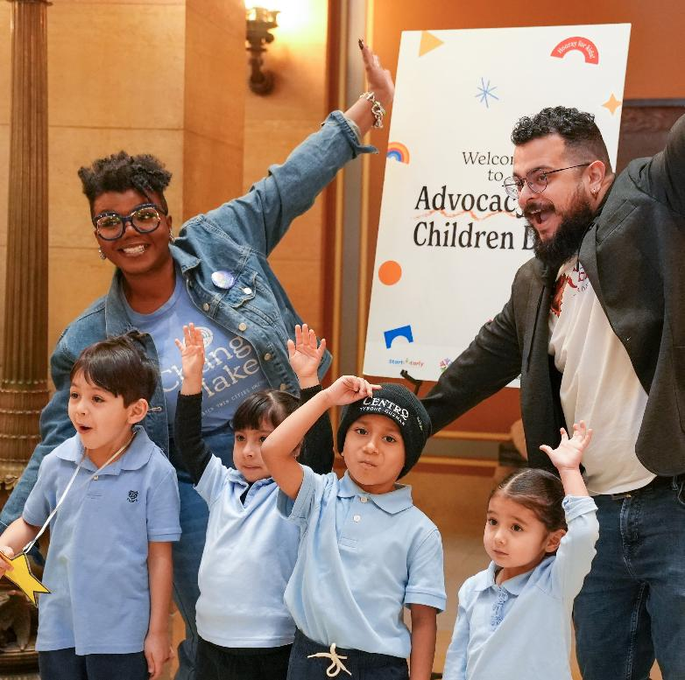
We make lasting change
Our 80x3: Resilient From the Start initiative is expanding the trauma-sensitive care that makes a difference in early childhood.
We lead advocacy to increase affordable, trauma-sensitive, culturally responsive early childhood care and education. And we support Supporting advocacy to empower young people with the resources to complete high school and prepare for well-paying, high-demand careers.
Notes:
Here’s how we make lasting change so young people have what they need to succeed:
Leading the 80x3: Resilient From the Start initiative to expand the trauma-sensitive care that makes a difference in early childhood.
Leading advocacy to increase affordable, trauma-sensitive, culturally responsive early childhood care and education.
Supporting advocacy to empower young people with the resources to complete high school and prepare for well-paying, high-demand careers.

Slide 17
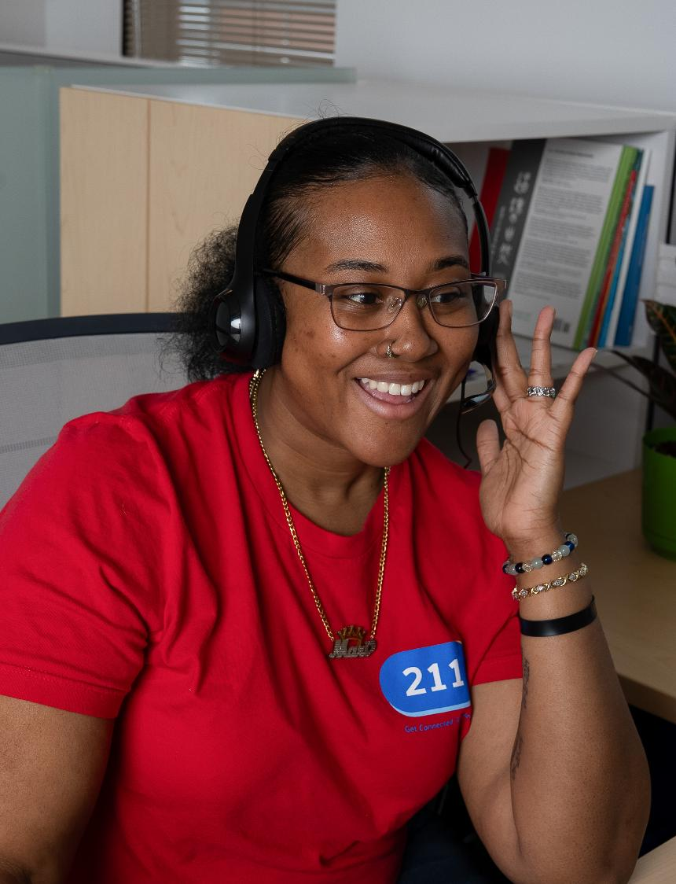
ECONOMIC OPPORTUNITY
UNITED IS THE WAY

Slide 18
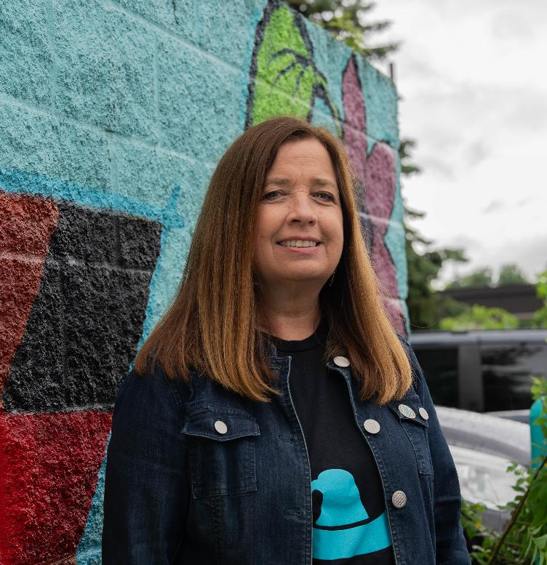
We meet urgent needs
211 callers find education and job-training resources and resources to meet their basic needs so they can focus on increasing earnings.
We support the nonprofits deeply engaged in community to provide job training, entrepreneurship support and access to safe financial products.
Notes:
Here’s how we meet urgent economic needs:
Connecting adults with educational and job-training resources through 211, and resources to help them meet their basic needs so they can focus on increasing earnings.
Supporting nonprofits deeply engaged in community to provide job training, entrepreneurship support and access to safe financial products.
This support is what our grantmaking team does every day.
It comes in the form of flexible, reliable multiyear funding
And we provide free consulting, which our partners tell us is crucial for their organizational stability. This means a lot in a turbulent funding and policy landscape.

Slide 19
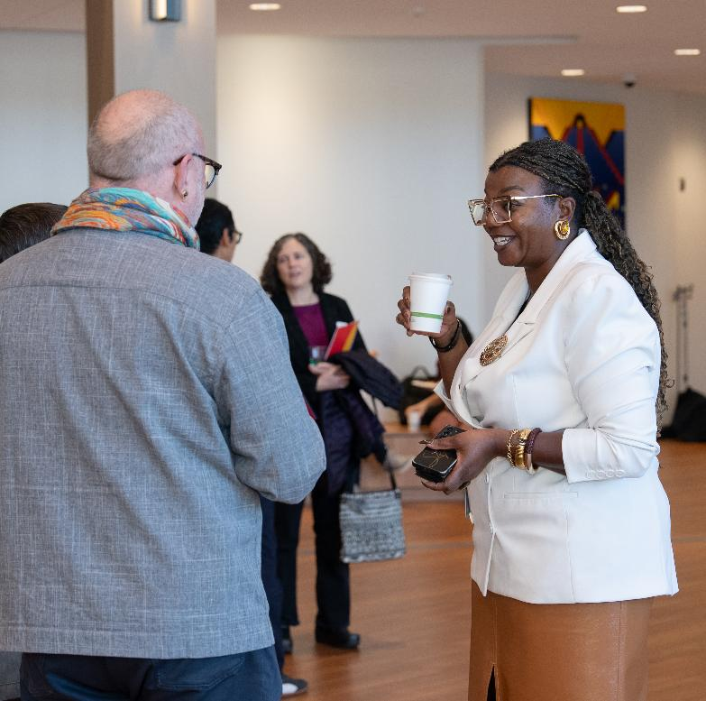
We make lasting change
Our Career Academies initiative is improving our education and workforce systems to effectively prepare students for the transitions from learning to high-wage, high-demand careers.
We support advocacy to increase wealth-building opportunities with state funding for affordable housing, economic stability and career pathways.
Notes:
We make lasting change so everyone has economic opportunity by:
Leading the Career Academies initiative to ensure our education and workforce systems effectively prepare students for the transitions from learning to high-wage, high-demand careers.
Supporting advocacy to increase wealth-building opportunities with state funding for affordable housing, economic stability and career pathways.

Slide 20
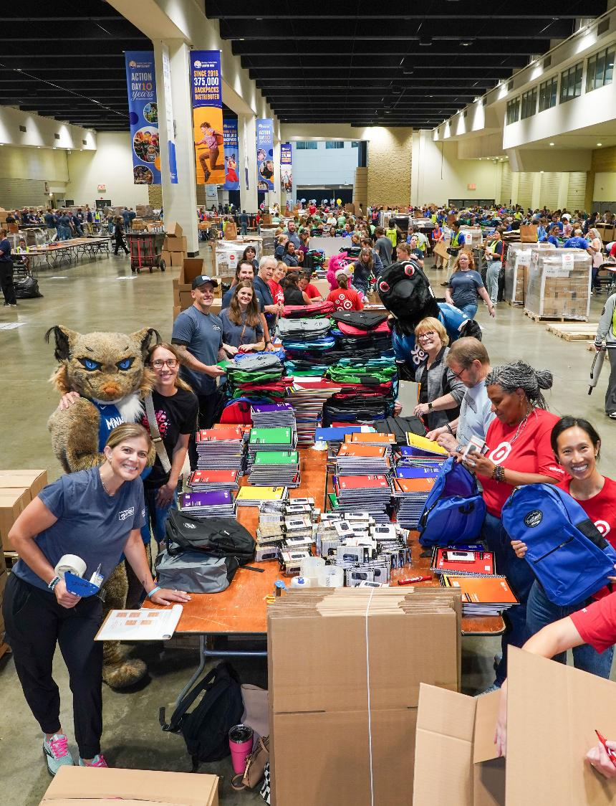
OUR IMPACT TOGETHER
UNITED IS THE WAY

Slide 21
In 2025, we responded.
211 responded to a request every two minutes on average, 24-7, from people seeking housing, emergency food services, quality child care and more. And our 988 Suicide & Crisis Lifeline answered more than 44,000 calls, a 33% increase vs. 2024.
We supported nonprofits dealing with the heartbreaking task of reducing services due to federal funding cuts. For example, we helped one nonprofit buy time for women and children to find their next housing option and preserve the stability they had begun to build.
Our volunteers showed up. More than 10,400 volunteers assembled backpacks full of school supplies for 62,475 K-12 students; 1,535 welcome home bins with essentials for families; and ingredients for families to share 57,760 meals.
And when food needs spiked, we acted quickly …
Notes:
In 2025, you made it possible for more than half a million local people to live more stable lives and work toward success with help from Greater Twin Cities United Way. Together, we:
Responded.
Our crisis counselors answered more than 44,000 calls to the 988 Suicide & Crisis Lifeline, providing hope for a brighter tomorrow. This was a 33% increase vs. 2024.
The specialists at our 211 resource helpline responded to a request every two minutes on average, 24-7, from people seeking housing, emergency food services, quality child care and more.
We helped housing partners deal with the heartbreaking task of reducing services due to federal funding cuts. For example, we helped one nonprofit buy time for women and children to find their next housing option and preserve the stability they had begun to build. This type of consultation with our multiyear nonprofit partners and responsive grantmaking is part of what our grantmaking team does all year round.
All year, our volunteers showed up. More than 10,400 volunteers assembled backpacks full of school supplies for 62,475 K-12 students; 1,535 welcome home bins with essentials for families; and ingredients for families to share 57,760 meals.

Slide 22
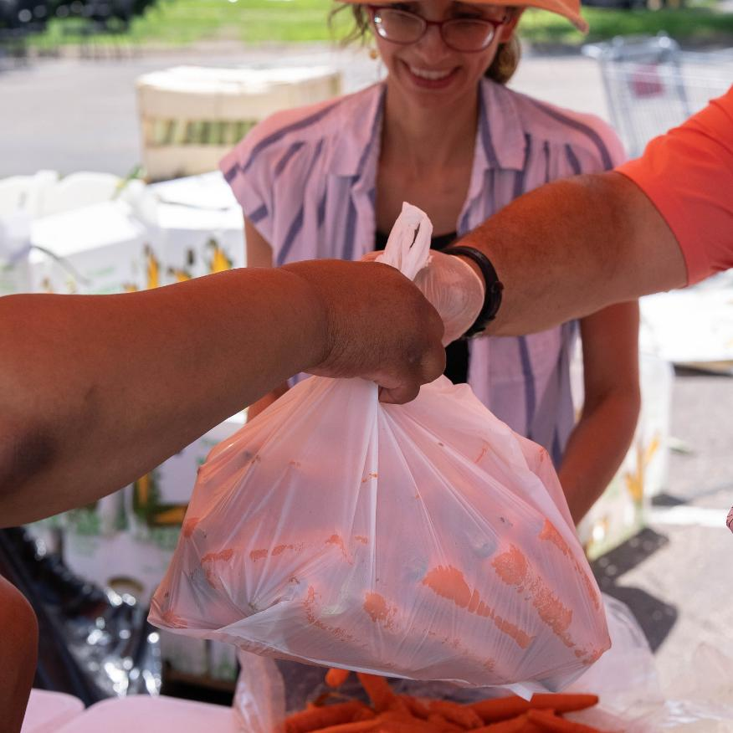
… We distributed $145,000 in emergency food grants and quickly mobilized volunteers to assemble 6,674 meal packs to stock local food shelves.
Notes:
When the federal government shutdown and changes to SNAP benefits caused a spike in demand for food, we acted quickly. 211 responded to a 232% increase in food-related calls. We distributed $145,000 in emergency grants to help nonprofits increase food supply. And in an emergency mobilization, volunteers assembled 6,674 meal packs to stock local food shelves.

Slide 23
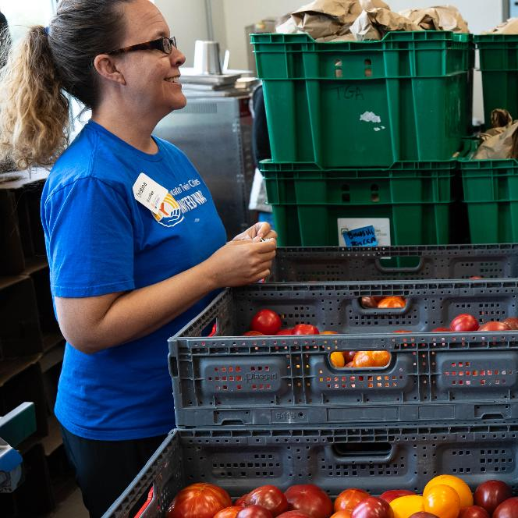
In 2025, on average …
Every 43 seconds, a neighbor facing hunger got groceries or a hot meal from a Greater Twin Cities United Way partner who cares about them.
Every two minutes, a 211 resource specialist helped a community member find shelter, food, quality child care and more.
Every 12 minutes, a caller to the 988 Suicide & Crisis Lifeline connected with a Greater Twin Cities United Way crisis counselor to find hope for a brighter tomorrow.
Every 20 minutes, a youth or adult started their career path with education, job training or entrepreneurship services from a Greater Twin Cities United Way partner who understands their individual strengths.
Notes:
Greater Twin Cities United Way is a persistent presence in our community. Because of your support we were here for each other, every minute of every day, throughout 2025. Here are a few examples of our impact. On average:
Every 43 seconds, a neighbor facing hunger got groceries or a hot meal from a Greater Twin Cities United Way partner who cares about them.
Every two minutes, a 211 resource specialist helped a community member find shelter, food, quality child care and more.

Slide 24
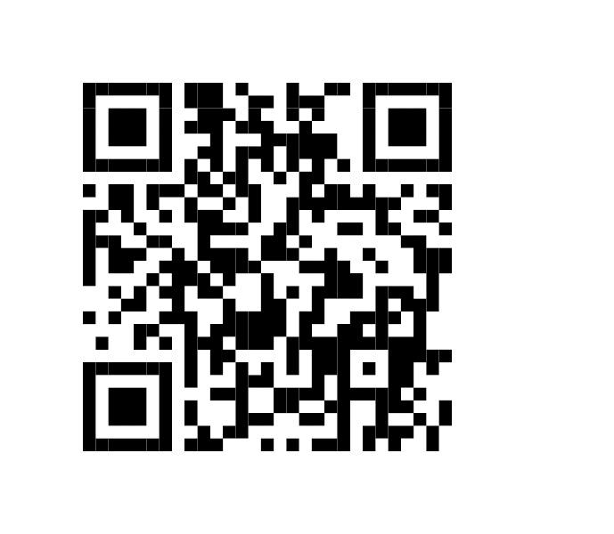
Stay connected
Scan here to receive updates on the impact you create.
Notes:
General email sign up.
Signup triggers a welcome series (weekly for a few weeks).
After that, folks should expect just one e-newsletter every-other month, plus occassional invitations to volunteer or attend events.
In general we don’t send more than 1-2 emails per month total. (This doesn’t count the 1-1 emails that managed donors get from relationship officers, or emails triggered by transactions such as making a pledge or volunteering for an event.)
Opt out anytime.

