Slide 1


FULL LIVES
PHASE 2 RFP
Q&A SESSION
April 23, 2026

Slide 2

AGENDA
  1:00 pm – 1:30 pm --- Informational Presentation
    Introductions from the Full Lives Team
    Full Lives Background
    Phase 2 Overview
    Application Process
    Grants Portal Usage
    Rubric & Resources
  1:30 pm – 2:00 pm --- Open Q&A Session
Notes:
Please add questions to the chat, we will keep track of them and start answering them during that second half hour period. If we don’t get to your question, we’ll explain how to reach out to us
We’ll send this slide deck and a recording after. Everything here is available in the RFP as well, but still highly encourage you to read the full RFP as much of that isn’t here

Slide 3
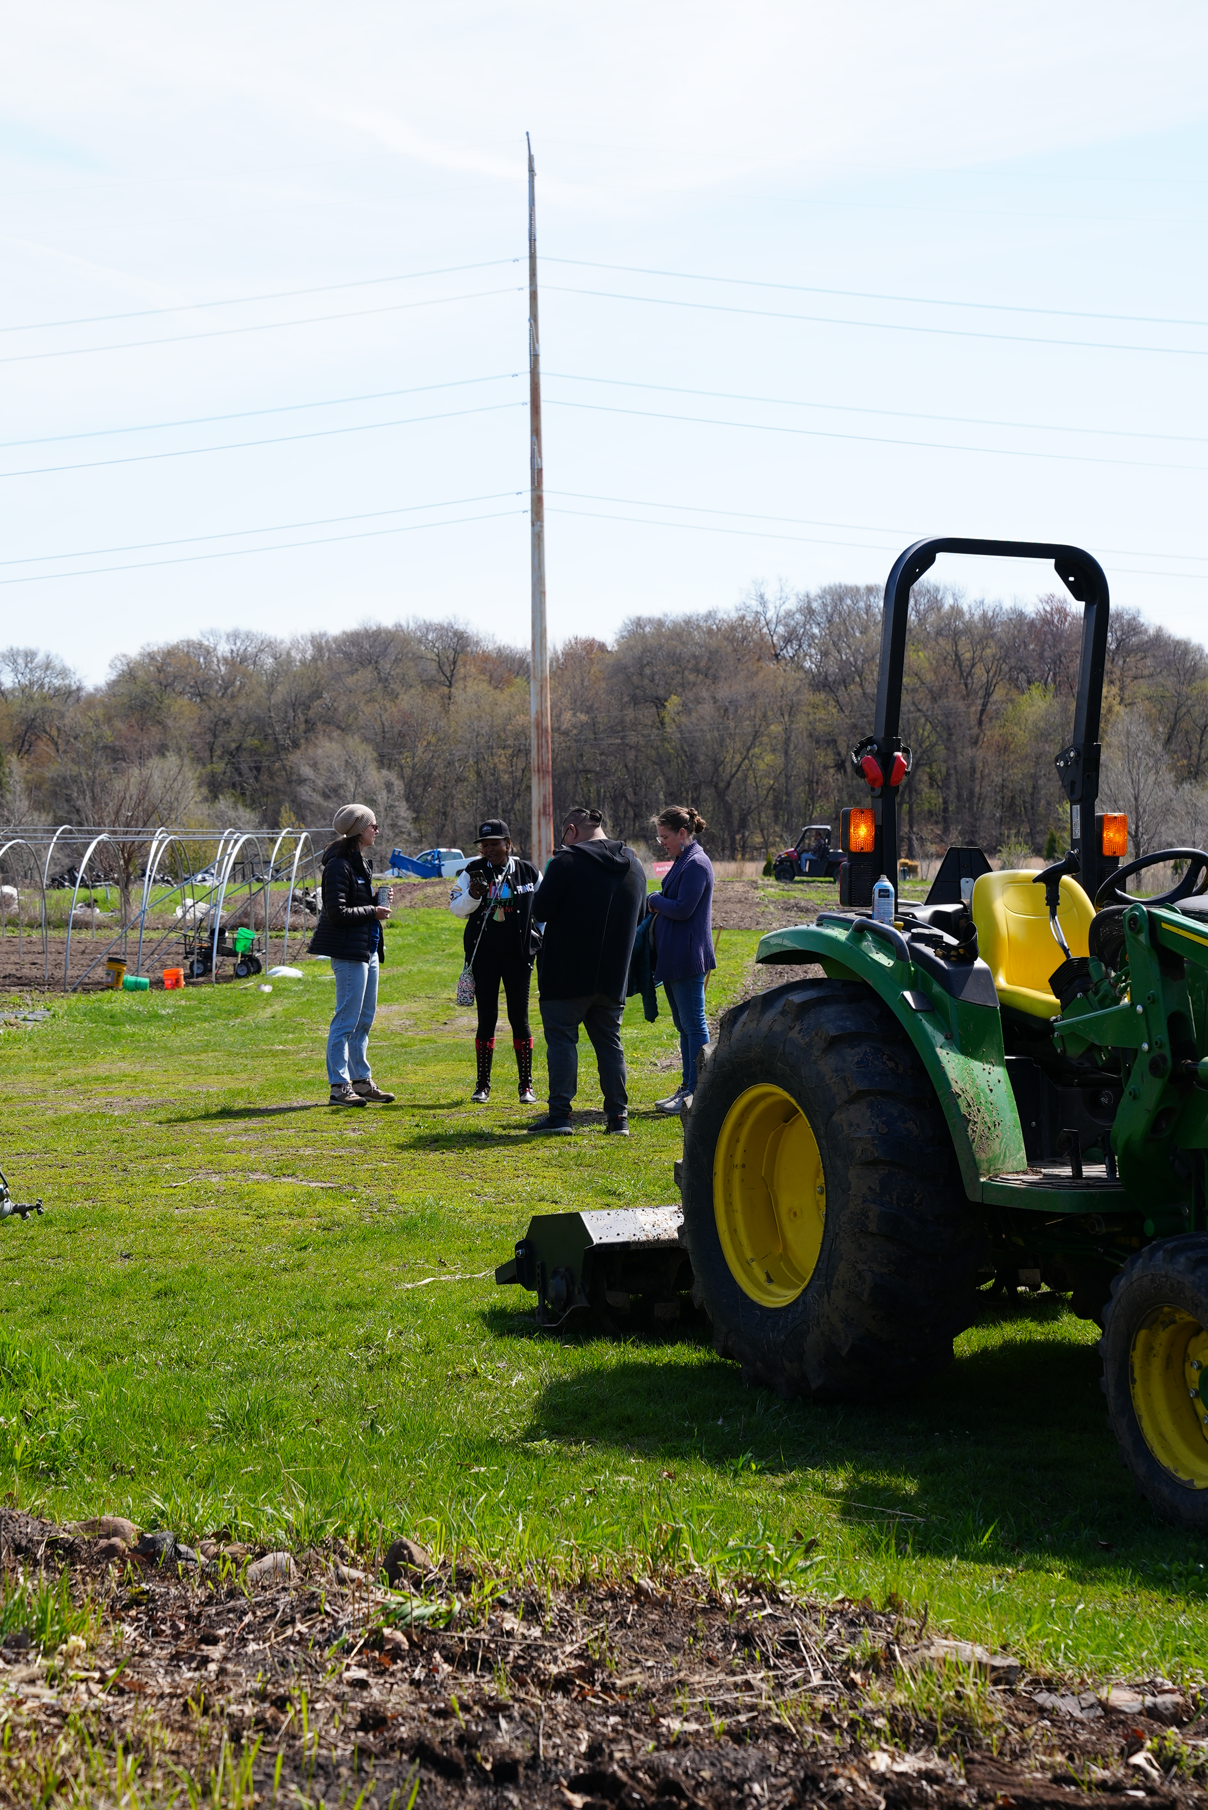
INTRODUCTIONS FROM THE FULL LIVES TEAM

Slide 4

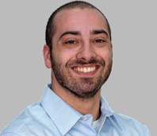
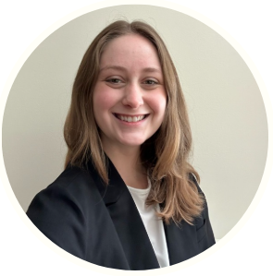
FULL LIVES TEAM
Katie Chatfield MPH, RDN
Zach Mellow
Grace McLean
Full Lives Program Officer
Program Manager
Operations Specialist
Katie.Chatfield@gtcuw.org
Zach.Mellow@gtcuw.org
Grace.McLean@gtcuw.org

Slide 5
FULL LIVES BACKGROUND

Slide 6

The Full Lives initiative focuses on strengthening the regional community food system to improve long-term food security.
Vision: A thriving and equitable Twin Cities regional food system where all communities have physical and economic access to food that meets their cultural, dietary, and nutritional needs.
“All of this work is feeding the community in a healthy way.”
-FULL LIVES FUNDED PARTNER
‹#›

Slide 7

PHASE 1 SNAPSHOT
  Grant Period: July 2024-December 2025
  Over 19 funded partner organizations
  3 key program components to build capacity
  Primary outcomes:
    Deepened and expanded relationships
    Increased capacity
    Trust-based partnership
Notes:
Partners in Phase 1: 4 collaborations, 3 capacity-building partners
Program design really focused on developing the capacity of collaboratives and networks operating in the food systems space through flexible funding, TA and in-person learning communities of practice
TA provided by Terra Soma and Propel Nonprofits

Slide 8
PHASE 2 OVERVIEW

Slide 9

PHASE 2: BACKGROUND AND RATIONALE
  Food production is not a limiting factor in our region; getting it to people is
  Goal: Address gaps in infrastructure and logistics to support the Twin Cities regional food system
  Two primary focus areas:
    Market access & business development
    Local food distribution and infrastructure
“Logistics are so important in connecting people to smaller, local producers and making that successful in terms of a job for somebody or a family business.”
-Full Lives funded partner
Notes:
-the program design and strategy for Phase 2 came directly from funded partners, conversations with other non-funded partners in the food system and the Full Lives Advisory Group

Slide 10
GRANT AWARD DETAILS
  Total Funding Amount: $900,000
  Anticipated Number of Funded Partners: 3-5 organizations
  Anticipated Individual Grant Awards: $175,000 - $275,000 each
  Geographic Area: 9-county Metro area (Anoka, Carver, Chisago, Dakota, Hennepin, Isanti, Ramsey, Scott, Washington)

Slide 11
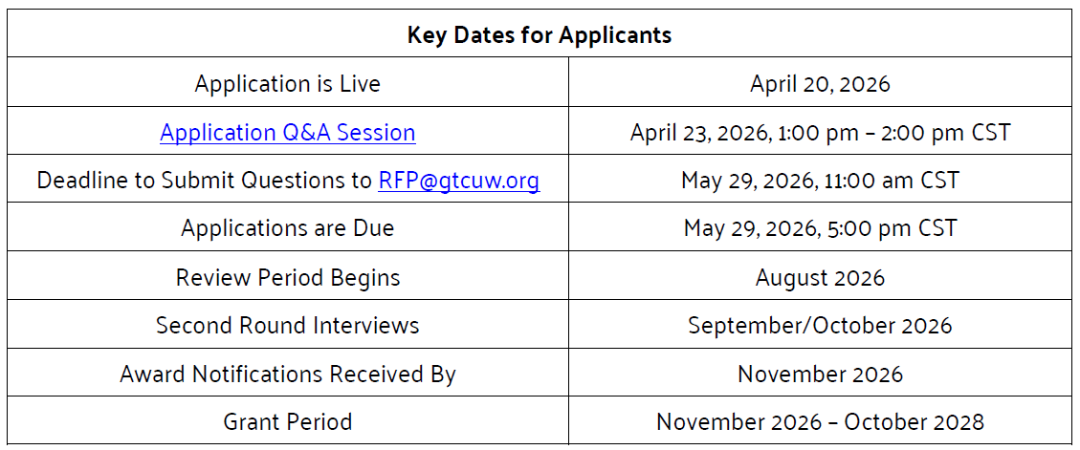
Notes:
Program officer will be on family leave over the summer, so we will be taking a pause between the application deadline and review process

Slide 12
RFP FOCUS AREAS - EXPLAINED
1. Expand Market Access and Business Development Opportunities for Small and Emerging Growers
Investing in organizations helping growers access new and more consistent market channels, thereby improving financial stability and expanding access to locally grown foods in communities
Supporting partners working to streamline the movement of local food from farm to market by investing in critical infrastructure and coordination along the supply chain
2. Strengthening Local Food Distribution Infrastructure and Coordination

Slide 13
RFP FOCUS AREAS – EXAMPLE ACTIVITIES
Creating or expanding connections with wholesale, institutional, retail, direct-to-consumer, or community-based settings (such as churches or food shelves)
Supporting growers in business development, marketing, and operational planning
1. Market access & business development
Coordinating and facilitating local food distribution efforts
Filling infrastructure gaps such as packing space, storage, refrigeration, and transportation
2. Local food distribution and infrastructure
Notes:
More example activities on the RFP
Not exhaustive
Highlight that the focus is systems change
-not just giving money to buy produce with no new additional partnerships or program build out
-looking to create long term sustainability

Slide 14

Strategic Partnerships
Integration of Focus Areas
Meaningful and intentional partnerships streamline resources, reduce redundancy and increase capacity
Proposed activities related to both market development and local food distribution
PHASE 2
FUNDING PRIORITIES
Community-
Centered
Equity & Justice
Prioritizing proposals with a clear focus on racial justice, equity, and inclusivity
Supporting and scaling community-centered initiatives that foster resilience and build upon ongoing efforts
Notes:
Focus areas guide the work you’re doing, funding priorities is how you’re doing the work.
Priority will be given to proposals that address both sides of the farm to market pathway: how food moves, and where it goes.

Slide 15
PARTNERSHIP INFORMATION
  Partnerships with other organizations are encouraged, but not required to apply
  Grant funds for allowable expenses may be passed through to partner organizations
      Include this information in Project Budget
  All partners integral to the project’s success should be listed on the application
  Applicants must submit a Letter of Commitment for each key partner outlining expectations for lead organizations and partners

Slide 16
FUNDING ELIGIBILITY
  Your organization or lead organization (for partnerships) is a 501(c)(3) nonprofit organization or has an established fiscal sponsor that is a 501(c)(3).
  Your organization's current fiscal year budget is at least $250,000.
  Organizations must operate within the Greater Twin Cities United Way nine-county service region (Anoka, Carver, Chisago, Dakota, Hennepin, Isanti, Ramsey, Scott, Washington).

Slide 17
FISCAL SPONSORSHIP
  If your organization is not a 501(c)(3) or does not have a budget of at least $250,000, please consider utilizing a fiscal sponsor
  A fiscal sponsor must meet all GTCUW eligibility requirements
  A fiscal sponsor would…
    Receive and manage grant funds on behalf of the project
    Take on legal and administrative responsibilities, including financial management and reporting

Slide 18
APPLICATION PROCESS

Slide 19
APPLICATION PROCESS
  Online Application – due May 29 by 5:00 pm CST
    Financial documentation
    General applicant information
    Nine narrative questions; Letter(s) of Commitment; Project Budget
  2. Virtual Conversations (if selected) – to take place in September/October
Notes:
As a reminder, we’re pausing the review process until our Program Officer is back from family leave in August.
Financial documentation: 990s, organization budget, audit, determination letter
Suggested word count for narrative questions: 200 – 400 words (depending on the question)
Providing word document for ease of drafting, but must submit in online portal
virtual conversation to talk more about their work and learn more about the Full Lives initiative
Key partners should be present for virtual conversations

Slide 20
PROJECT BUDGET
  Applicants will complete a Project Budget that details how grant funds will be used
  Indicate any funds passed through to key partners
  Administrative costs must not exceed 10% of total grant request
Notes:
We have provided a budget template

Slide 21
GRANTS PORTAL USAGE

Slide 22
GTCUW GRANTS PORTAL – INSTRUCTIONS FOR NEW USERS
  Check to see if you have an existing account by entering your work email as your username and your password. If your email is recognized and you need a new password, click Forgot User ID or Password? If your email is not recognized and you need to create an account, proceed to step 2.
  If you need to create an account, fill out our online form to get started. It may take our team 3 business days to get your account up and running. If you already have an account, please refer to the next slide for Current Users on how to receive access to open GTCUW RFPs.
  Once your account has been created, you will receive an automated email from RFP@gtcuw.org directing you to log in to your Grants Portal account.
Notes:
This is taken from the RFP, in the RFP there are handy dandy hyperlinks to use

Slide 23
GTCUW GRANTS PORTAL – INSTRUCTIONS FOR PRESENT USERS
  Log in to your online Grants Portal account. If you don’t have a login, refer to the previous slide for instructions on creating one.
  First check if you already have access to your desired RFP(s).
    After logging in to your Grants Portal account, navigate to the Applications/Reports tab at the top of the web page to check which RFPs you currently have access to.
  If you don’t see your desired RFP(s) available in the Applications/Reports tab, navigate to the Sign Up for Open RFPs tab and sign up for the Full Lives RFP. It may take our team 3 business days to process this request and for you to see the requested RFP(s) in your Applications/Reports tab.
Notes:
Must click submit on every section

Slide 24
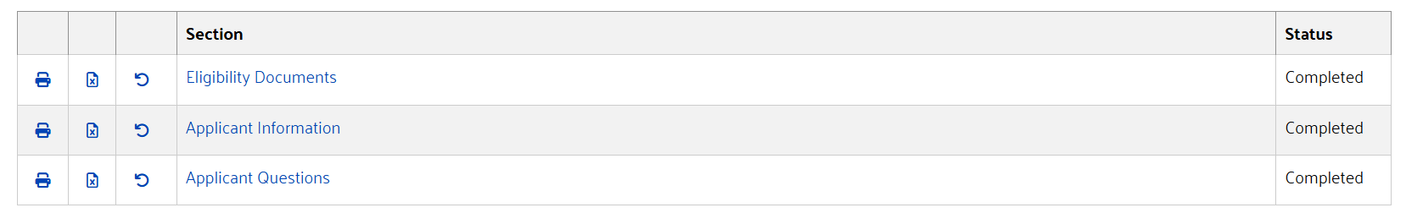
SUBMITTING YOUR ONLINE APPLICATION
How to know you’ve fully submitted
How to reopen a section after submitting
Notes:
You’ll also get a confirmation email

Slide 25
RUBRIC & RESOURCES

Slide 26
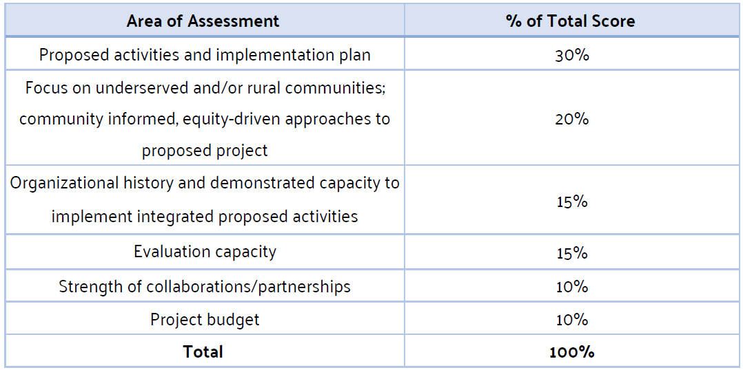
PROPOSAL ASSESSMENT RUBRIC
Notes:
Takes into account funding priorities, directly related to questions on the application

Slide 27
RESOURCES
  RFP
  Q&A Session
    Slides and recording will be available on our website
  Meetings with the Full Lives Team
      Dates available until May 21, 2026
  GTCUW Grants Portal Info Sheet
  Email us at RFP@gtcuw.org with any general questions
    We will be unable to answer questions the afternoon of the application due date – May 29, 2026
Notes:
Grace will put the RFP and landing page links in the Chat at this point

Slide 28
OPEN Q&A
Notes:
Stop sharing screen
Repeat questions as we read them out
If you have an application specific question, please reach out to us directly or take advantage of bookings links

Slide 29

‹#›

